Slide 1




Modern Luxury
What it takes for Luxury Marketers to thrive
2024

Slide 2

Luxury marketing is an artform
If art is a reflection of society, what can Luxury Marketers learn?

Slide 3
Despite common perception,
luxury brands are not immune
to market volatility.
Luxury consumer spending saw a 7% decrease in the US in 2023, compared to a 12% increase in 2022.
3-year change in gross profit generated per marketing dollar
Source: Forbes
Notes:
https://www.forbes.com/sites/pamdanziger/2024/02/19/387-billion-luxury-market-remain-turbulent-here-are-the-bright-spots/?sh=59c133ad19

Slide 4
Consistently relevant brands operate under the assumption that customer loyalty is not a given, and reinvention is table stakes.
40% of CEOs don’t think their companies will be economically viable in 10 years.
Source: PwC Global CEO Survey

Slide 5
70%
of executives define an active customer as one who has been active for up to 90 days.
However, the luxury customer journey can span a lifetime and cross generations.
Source: PwC’s Customer Loyalty Survey

Slide 6
The
Mass Market vs. Luxury Dichotomy
Mass Market
Luxury
Speed-Driven Value
Turnaround times, fulfilment, and delivery
Timeless & Enduring
Experiences and value
Transactional
Greater potential for “one and done” relationships
Lifetime Value
Longer-term customer connections
Consumer Flexible Journeys
Customer-focused purchasing paths and omni-channel marketing tactics
Brand Powered Experiences
Traditional purchasing paths, with targeted innovation by some brands
Product Led Competition
Go to market models that compete on on price, service, price, or product
Brand Led Competition
Competing with brand power supported by product, service, and rarely price
What can luxury brands learn from their counterparts while staying true to their essence?
Ubiquitous
Reachable, obtainable products and services
Unique
Products and services marketed to be rare and distinctive
ROI-Oriented Spend
Marketing dollars justified by clear mROI
Experiential and Holistic Spend
Marketing focused on elevating brand, holistic equity, and often ROE equally important to ROI
Technology heavy
Marketing tactics focused on low cost, scaled solutions and platforms
Human powered, tech enabled
Blend of human and tech enabled marketing tactics that enable frictionless and personalized client engagement

Slide 7






Timeless Customer Relationships
Take a long term view and focus on Customer Lifetime Value.
Have a strong brand identity that prudently evolves.
Listen and learn from customers and employees on what works.
So, what does it mean to bring timelessness
to customer relationships?
Fix mistakes as quickly and effectively as possible.
Continuously optimize, personalize, and differentiate the experience.
Understand and enhance YOUR value chain, enabled by prudent tech and data models.

Slide 8
Lifetime Value
Modern marketers who focus on earned & owned experiences drive higher lifetime value than those associated with “one and done” campaigns.
10-15%
value lift associated with enhancement of organic engagement and optimization of content in owned channels.
Sources: PwC Strategy& Analysis

Slide 9
Brand-Centric Experiences
The
Experience Gap
Many organizations are not getting the experience right,
nor are they delivering on the brand promise customers expect.
17%
Surveyed consumers average gap between the experience they expected vs. what the brand delivered.
Source: PwC Consumer Intelligence Series: Future of Customer Experience

Slide 10
Experience Gaps by Industry
Across most industries,
many organizations are not getting the experience right, nor are they delivering on the brand promise customers expect.
Airlines
Healthcare
Pharma
Retail
Banking
Investments
Mobile / Internet
Insurance
Software
Technology
Restaurants
Hotels
Sports
Media
33%
25%
22%
21%
20%
19%
19%
18%
14%
13%
12%
10%
10%
8%
20%
40%
60%
80%
Sources: PwC Consumer Intelligence Series: Future of Customer Experience
Consumer Actual
Consumer Expectations

Slide 11
Brand-Centric Experiences
So…how should Luxury Marketers close the
Experience Gap?
Listen (really listen)
Drive and refresh VoC programs, including prioritizing robust input from employees on experience.
Harness Customer Data
Blend and harmonize insights across touchpoints and prioritize real-time capabilities.
Deliver Exceptional Employee Experience
They are the first customer touchpoint, their experience impacts service to customers and brand sentiment.
Effectively Segment & Personalize
Avoid one size fits all models by deeply understanding and delivering on wants, needs and preferences.
Take Action
Evolve ways of working based on VOC and employee feedback results, fund regular motions to maintain impact.
Find and Protect Your Sweet Spot
Exit or close gaps in markets, segments and channels that aren’t delivering value.
Build better, broader relationships to
evolve employee & customer experience.
When it comes to technology & data,
do more with more.

Slide 12
Brand-led Experience
Luxury marketers are more likely to prioritize experience over price as a differentiator, which leads to compounding customer loyalty.
#1
Poor experience is the most likely reason a consumer will abandon a brand.
Sources: PwC Customer Loyalty Survey, 2023

Slide 13
Brand-led Experience
Center on Customer Values
Connected and consistent experience across physical and digital touchpoints
Blend Purchase Paths
Connected and consistent experience across physical and digital touchpoints
Key levers
to deliver the right
Customer Experience
Proactive Outreach
Meeting customers with massaging or experiences outside of transactions forges stronger bonds
Cultivate a ‘Fandom’
Provide experiences that aren’t transactional that add community and purpose to customers
Surprise & Delight
Deliver highly personalized and relevant content and experiences
Treat Sales as Marketing
Digital and in-store sales experiences should serve as an extension of marketing promises
Establish Unique Identity
Proriotize creative aspect of experiences to establish niche and differentiation
Service as a Premium
Service experiences should closely align with brand promises and exceed expectations

Slide 14
Unique
Many customer value chains are optimized for throughput, but…
ideas and innovation
that tie to brand promise would drive greater value.
CREATE
MARKET
SELL
FULFILL
CARE
Product Concept & Design
Segment Analysis
Campaign Execution
Provision Product
Customer Service
Insights Assessment
Develop Value Proposition
Channel Capacity Planning
Quality Assurance
Retention & Follow-Up
Market Opportunity
Campaign & Brand Communications Strategy
Sales Planning
Product Development
Selling Process & Sales Support

Slide 15
Unique
Many customer value chains are optimized for throughput, but…
ideas and innovation
that tie to brand promise would drive greater value.
CREATE
MARKET
SELL
FULFILL
CARE
Product Concept & Design
Segment Analysis
Provision Product
Customer Service
Product Concept & Design
Campaign Execution
How is this product unique / differentiated?
Insights Assessment
Develop Value Proposition
Channel Capacity Planning
Quality Assurance
Retention & Follow-Up
Research & Development
Campaign & Brand Communications Strategy
Market Opportunity
Sales Planning
Product Development
What is the target addressable market?
Selling Process & Sales Support

Slide 16
Unique
Many customer value chains are optimized for throughput, but…
ideas and innovation
that tie to brand promise would drive greater value.
CREATE
MARKET
SELL
FULFILL
CARE
Segment Analysis
Product Concept & Design
Segment Analysis
Provision Product
Customer Service
Product Concept & Design
Campaign Execution
How is this product unique / differentiated?
Which segment places outsized value on our products?
Insights Assessment
Develop Value Proposition
Channel Capacity Planning
Quality Assurance
Retention & Follow-Up
Research & Development
Campaign & Brand Communications Strategy
Market Opportunity
Sales Planning
Product Development
What is the target addressable market?
Selling Process & Sales Support

Slide 17
Unique
Many customer value chains are optimized for throughput, but…
ideas and innovation
that tie to brand promise would drive greater value.
CREATE
MARKET
SELL
FULFILL
CARE
Product Concept & Design
Segment Analysis
Campaign Execution
Provision Product
Customer Service
Which segment places outsized value on our products?
How can quality assurance drive customer connection?
How is this product unique / differentiated?
Insights Assessment
Develop Value Proposition
Channel Capacity Planning
Quality Assurance
Retention & Follow-Up
Market Opportunity
Campaign & Brand Communications Strategy
Sales Planning
What are the right connection points to unlock long term CLV?
Product Development
What is the target addressable market?
Selling Process & Sales Support

Slide 18
Experiential Spend
Marketers know their budgets are on the chopping block.
89%
of CMOs believe their budget will be cut before other departments.
Source: PwC CMO Pulse Survey of 722 marketing executives & CMOs, 2022

Slide 19

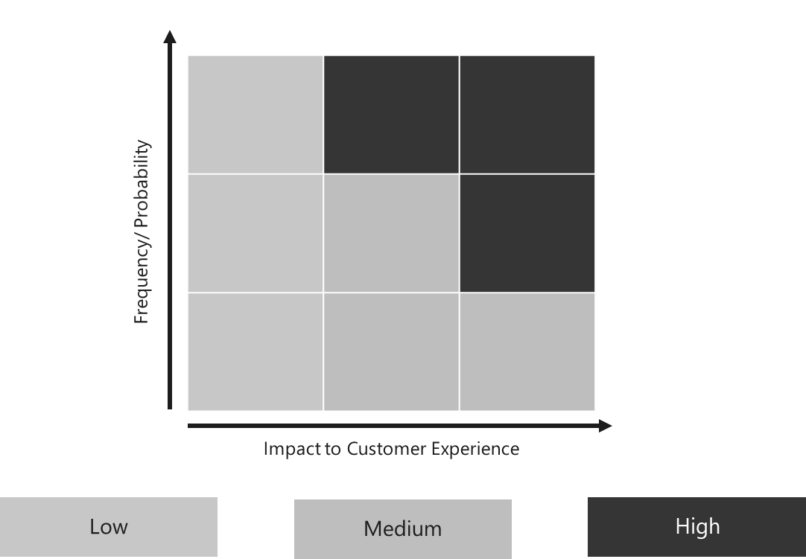
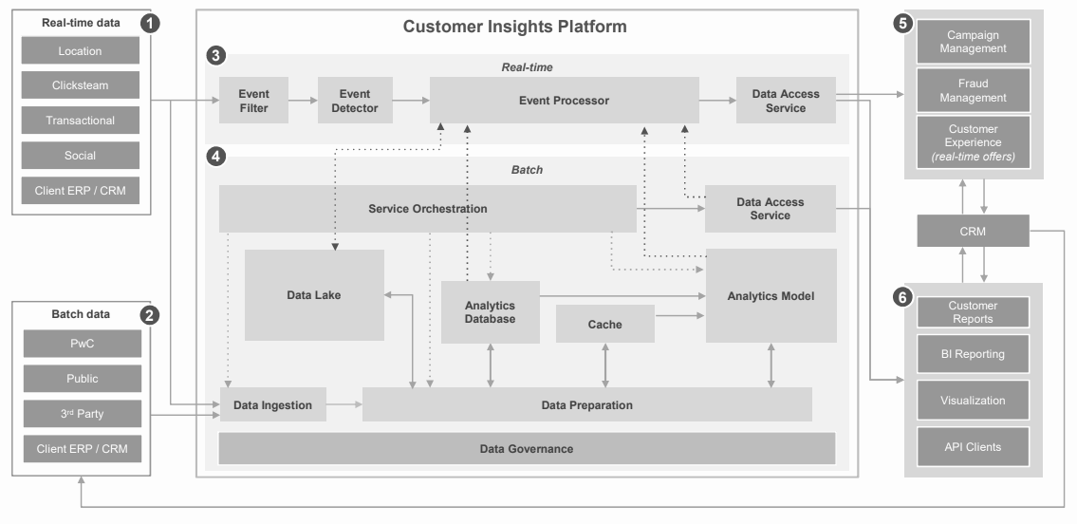
Experiential Spend
For the right investments, we recommend CMOs consider:
Will this be worth it?
Quality & Impact of Enabling Experience
What gap do we need to fill?
Investments Required to Deliver Experience
What is the probability of positive associations with the experience, and the impact of that experience?
What is the lifecycle, timeframe, and cost of investments and enablers to deliver a comprehensive experience?
EXAMPLE
Customer receives an email announcing a launch event for a new product at their local store, they’re given the ability to register and bring a friend to the experience.
EXAMPLE
Customer is in the market for jewelry for an event, they’re seamlessly able to see their local store is out of stock and ship it on time to their home address.

Slide 20



Human-led Technology
When it comes to human-led technology, there are
three primary focus areas to find the right balance
Ad Formats & Channels
Understand where
to reach your customers
Data and Tools
Make your data work harder for you
GenAI
Know where to start,
and what to avoid

Slide 21
Human-led Technology | Ad Formats
In aggregate, we forecast the following in terms of format growth (the right balance varies by brand)
Get ahead on channels poised for disruptive innovation
Dynamic OOH
Video Games / eSports
Between 2023 and 2027, video-focused ad formats are
projected to grow at a CAGR of
(including video gaming, AR / VR, OTT video, and cinema)
Sustainable print
Augmented Reality
Podcast & Audio
Virtual Reality / Metaverse
Consider areas of typical under-investment
Mobile Internet Ads
OTT Video
10%
Commerce & Retail Media
Short-form Video Ads
Be weary of channels with typical over-investment
Traditional TV
Traditional Music & Radio
OTT Video with Poor Quality / Strategy
Source: PwC Global Entertainment & Media Outlook, 2023

Slide 22

Human-led Technology | Ad Formats
Spatial
Experiment with visionary experience reimagination in smart cities and smart venues.
Search
PC search losing ground to mobile search and retail media spend.
Video
Continue investing alongside healthy growth rates, particularly in mobile formats.
Metaverse
Accelerate innovation to meet continued platform adoption gains and innovative use cases to drive relevance, particularly with younger consumers.
Social
Incorporate continued evolution in personalization, attribution, and measurement.
Email
Mitigate European regulations and consumer data protections that continue to impact scale, leverage GenAI to transform ROI.
Influencer Marketing
Drive brand safe and long lasting relationships that remain the exception and not the rule.
Print Advertising
View the bigger picture beyond declining growth rates to understand how to be impactful within the right customer segments and markets.

Slide 23
Human-led Technology | Data and Tools
The modern CMO's secret sauce is to harness data.
Great marketers also empower talent, and are customer obsessed.
Select strategic technology partnerships
Prioritize the right aspects of customer data
Balance real-time with periodic data flows to reduce complexity
Make data accessible to unlock insights and enable actions
Treat data innovation and optimization as a long term play

Slide 24
Human-led Technology | Generative AI
Where are modern marketers adopting GenAI?
We recommend marketers start with…
Define GenAI goals and prioritize key high level experiences
Assess current state of data and ML / LLM models
Prioritize core capabilities for GenAI success (unlock innovative use cases, address current state gaps)
Secure funding and build cross functional team
Establish agile GenAI use case innovation and prioritization team to enable test and learn models
We often see marketers forget to…
Develop data collection and governance strategy
Explore impact on partner and supplier expectations
Implement Responsible AI governance practices
Provide organization-wide training
Balance cost savings with innovation potential
Value Chain
Adoption
Insights
Medium
Strategy
Medium
Content Creation
High
Production
High
Campaign Activation
High
Campaign Optimization
Medium
Reporting
Low
Source: PwC Experience

Slide 25
Mass Market vs. Luxury Dichotomy
Luxury Marketer’s Advantage

Slide 26
Thank you
pwc.com
© 2024 PwC. All rights reserved. PwC refers to the US member firm, and may sometimes refer to the PwC network. Each member firm is a separate legal entity. Please see www.pwc.com/structure for further details. This content is for general information purposes only, and should not be used as a substitute for consultation with professional advisors.

